Slide 1
BIRTH RATE, GDP PER CAPITA AND WORLD POPULATION GROWTH
Alain Tabue

Slide 2
Dataset(s)
Which dataset did you use of the following:
Soccer Dataset
IMDB Movie Dataset
World Development Indicators Dataset

Slide 3
Motivation
The world’s population now excedds 7 billion people, up from around 3 billion in 1960. So It has more than doubled in the last 59 years. This exponential rate of growth is not sustainable over the long term. With a very limited amount of resources (water, arable land, living areas, energy sources, etc.) to share, our planet Earth can simply not sustain such an explosive population indefinitely. Many believe that it will lead to an acute crisis at some point in the future, as an overflowing population struggles to cope.
Some argue however that this doomsday scenario will not materialize because the world population will level off and even decline as the world develops, thanks to a sharp decline in birth rate. They contend that when people get richer, they bear fewer children. Therefore, developing nations (which account for most of the world population growth) will see their populations plateau or decline as they develop.
In this mini-project, we want to see if this argument is backed up by the data. Looking at the World Bank’s “World’s Development Indicators” dataset available on Kaggle , we want to find out how much different parts of the world have been developing, how fast their birthrate has been falling, and how much that has affected the overall population growth over the last 50 years.

Slide 4
Research Question(s)
1- Does Birth Rate decline sharply around the world as countries get richer ( as measured by GDP per capita)?
2- Do countries see their population growth slow down as result?

Slide 5
Findings

Slide 6
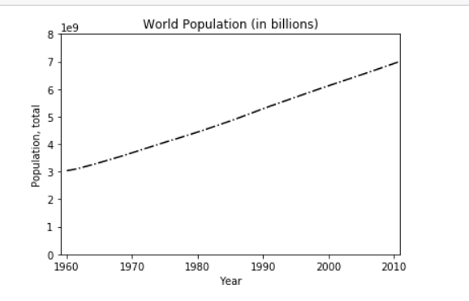
World Population Growth
* Indeed, the world population has grown from 3.03 billion people in 1960 to 7.17 in 2014, an increase of 137% in 54 years

Slide 7
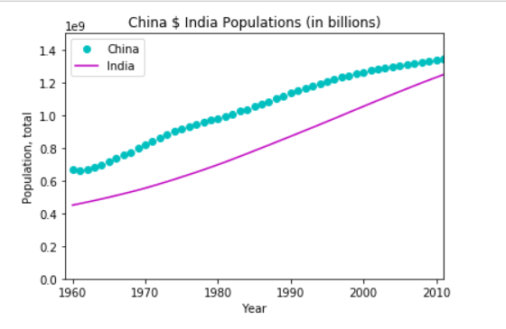
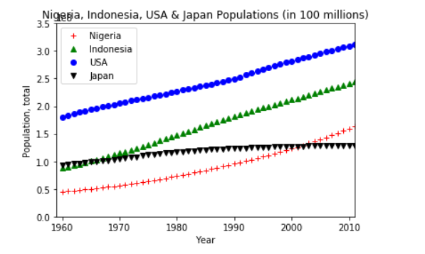
Insights into the World population
China & India, which account for 36.75% of the world population, have more than doubled their population while Indonesia and Nigeria have tripled theirs
The USA has almost doubled its population in the same period, while Japan largely kept its population unchanged

Slide 8
How do these population dynamics relate to Development Level (GDP per capita) and Birth rate?

Slide 9
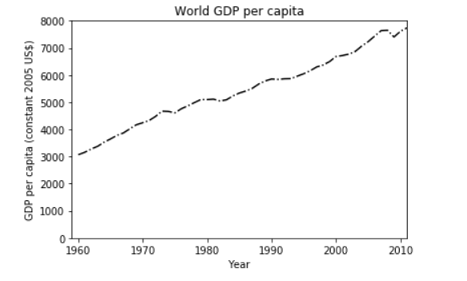
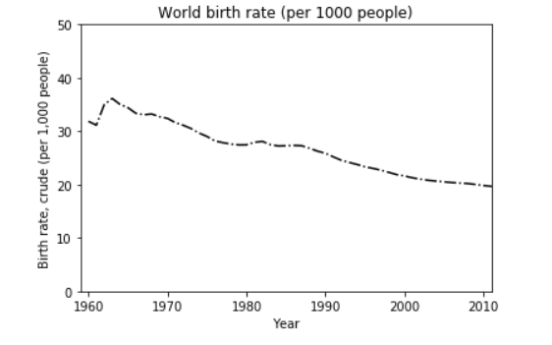
Overall, World GDP per capita and Birth rate
*
* Overall, while the world population was increasing by over 136%, the world GDP per capita was ingreasing by over 158% and its birth rate decreasing by over 86%

Slide 10
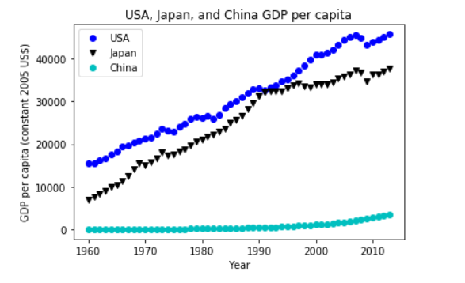
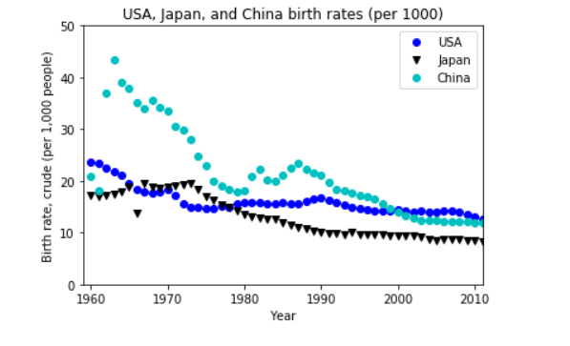
Insights – Richest countries
*
* The USA and Japan’s GDP per capita increased four fold, but more interestingly, China’s birth rate plummeted to levels similar to those of Japan and the USA. It therefore has little to no room for further decline.

Slide 11
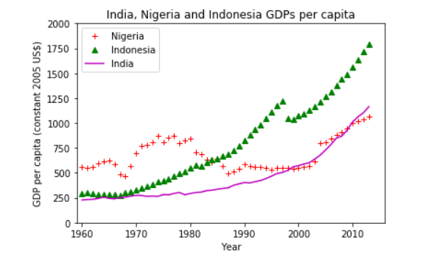
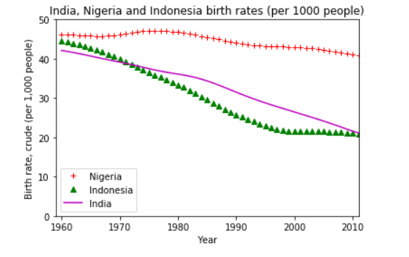
Insights – Developing countries
* The GDP per capita was multiplied by 6 in Indonesia, 4 in India, and a little less than 2 in Nigeria. The birth rate tells a more interesting story: It declined by more than half in Indonesia and India, leaving those countries only a limited room (10 points) for further decline. In Nigeria however, the birth rate remains very high.

Slide 12
Conclusion
It is true that the world population has been growing exponentially over the last 50 years.
The data also confirms that as countries get richer (as measured by GDP per capita) their birth rate tend to decrease sharply.
However, most of the birth rate decline has already occurred. Large reservoir of population like China, India or Indonesia, either are already at rock-bottom levels of fertility, or not far from it. So Birth rate decline alone cannot be counted upon to slow down or stop the explosive world population growth.
Other factors are at play here (advances in health care and technology, increases in life expectancy, etc.), and we are heading into a population crisis at some point in the future, barring breakthroughs in the areas of Climate Change, Resource utilization, Co2 emissions, renewable energy, etc..

Slide 13
References
1- “World Development Indicators” dataset from Kaggle.
2- Wikipedia

